Slide 1
Announcements
Midterm 2
Next Wednesday Nov 9 at 7:00 pm
Covers everything up to last Thursday (nothing this week)
OK to bring a two sided, handwritten cheat sheet.
Adam’s Office Hours moved (permanently).
Will be Thursday 11:30 – 12:30, 329 Soda

Slide 2
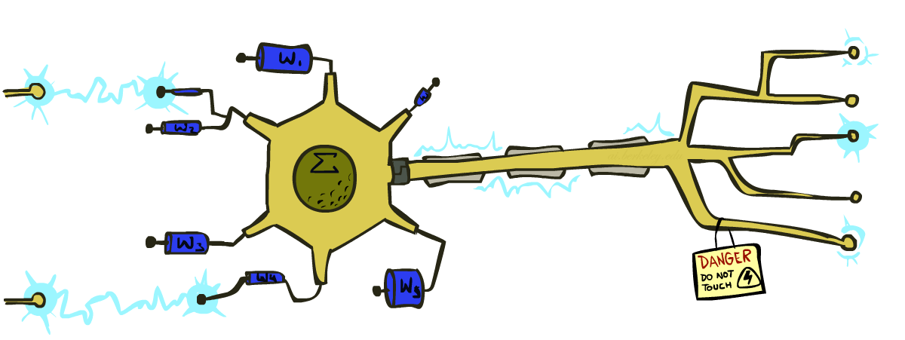
CS 188: Artificial Intelligence
Perceptrons
Instructors: Adam Janin, Josh Hug --- University of California, Berkeley
[These slides created by Dan Klein, Pieter Abbeel, Anca Dragan, Josh Hug for CS188 Intro to AI at UC Berkeley. All CS188 materials available at http://ai.berkeley.edu.]

Slide 3

Summary From Last Time
Can perform classification by creating a Bayes Net model and performing probabilistic inference
The Naïve Bayes model assumes all features to be independent given the class label
Can infer parameters (values for our CPTs) using “training data”
Smoothing our estimates is important in real systems
Zero probabilities in our CPTs is a particularly deadly type of overfitting
Use “held-out” data to tune smoothing hyperparameters
Y
F₁
F₂
F_{n}

Slide 4
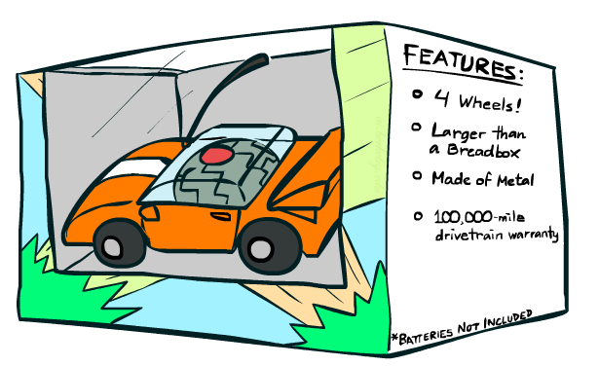
Features

Slide 5
Errors, and What to Do
Examples of errors
Dear GlobalSCAPE Customer,
GlobalSCAPE has partnered with ScanSoft to offer you the latest version of OmniPage Pro, for just $99.99* - the regular list price is $499! The most common question we've received about this offer is - Is this genuine? We would like to assure you that this offer is authorized by ScanSoft, is genuine and valid. You can get the . . .
. . . To receive your $30 Amazon.com promotional certificate, click through to
http://www.amazon.com/apparel
and see the prominent link for the $30 offer. All details are there. We hope you enjoyed receiving this message. However, if you'd rather not receive future e-mails announcing new store launches, please click . . .

Slide 6
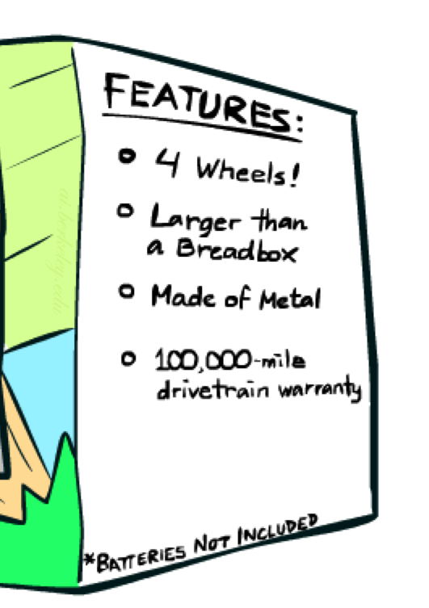
What to Do About Errors?
Need more features– words aren’t enough!
Have you emailed the sender before?
Have 1K other people just gotten the same email?
Is the sending information consistent?
Is the email in ALL CAPS?
Do inline URLs point where they say they point?
Does the email address you by (your) name?
Can add these information sources as new variables in the NB model
This lecture: A new type of classifier which is trained by reacting to errors.

Slide 7
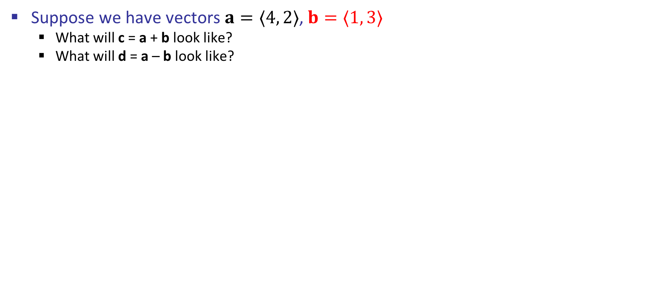
Very Brief Vector Review
c
Suppose we have vectors $a=〈4, 2〉$, $b=〈1, 3〉$
What will c = a + b look like?
What will d = a – b look like?
b
a

Slide 8
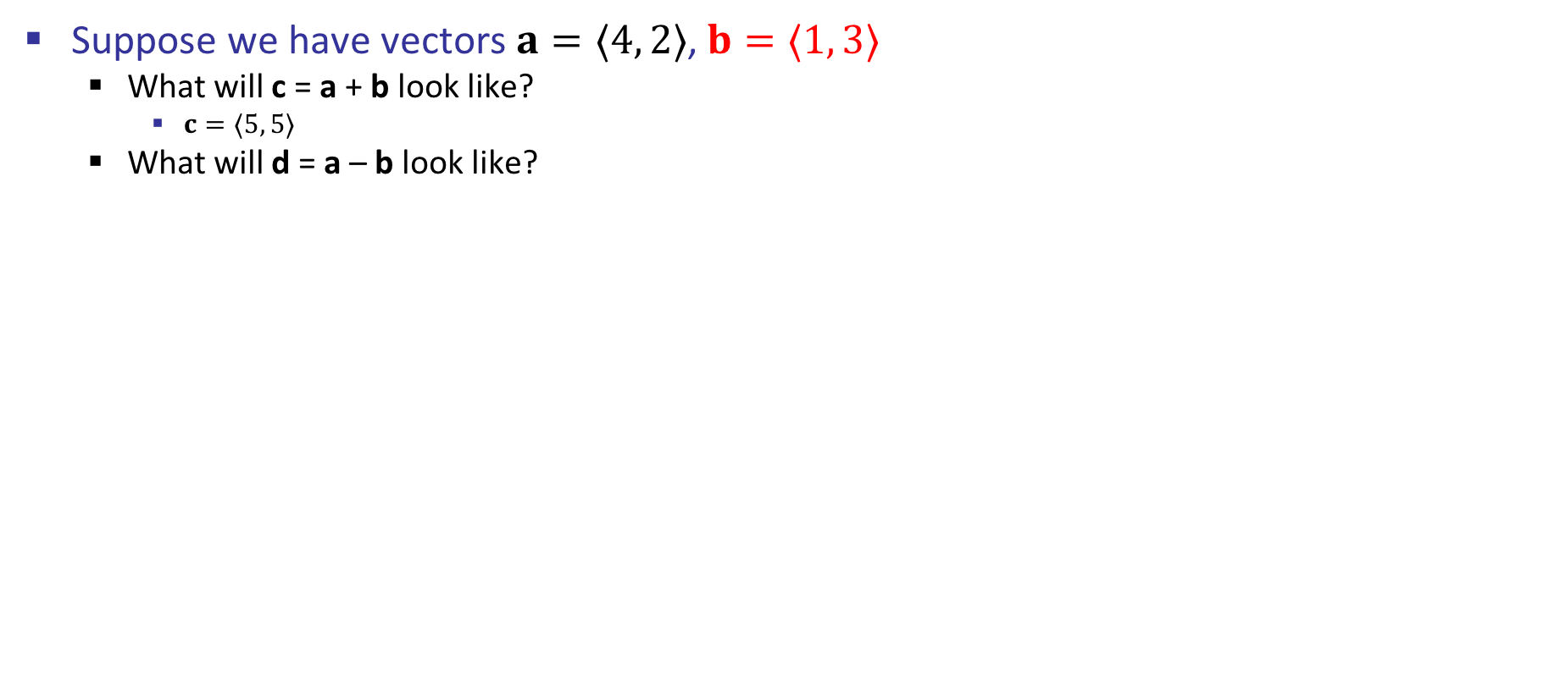
Very Brief Vector Review
c
Suppose we have vectors $a=〈4, 2〉$, $b=〈1, 3〉$
What will c = a + b look like?
$c=〈5, 5〉$
What will d = a – b look like?
b
c
a

Slide 9
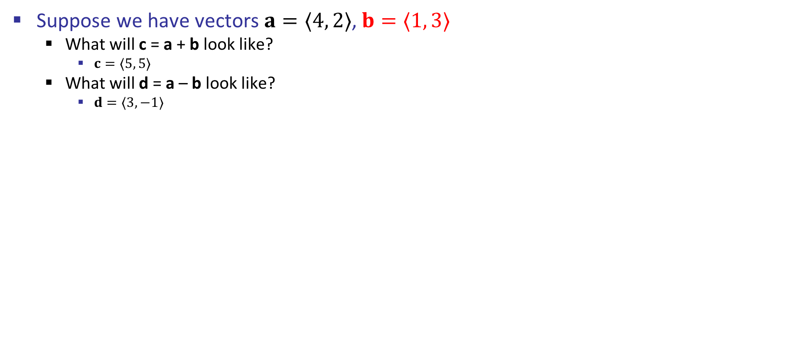
Very Brief Vector Review
Suppose we have vectors $a=〈4, 2〉$, $b=〈1, 3〉$
What will c = a + b look like?
$c=〈5, 5〉$
What will d = a – b look like?
$d=〈3, −1〉$
a
b
d

Slide 10
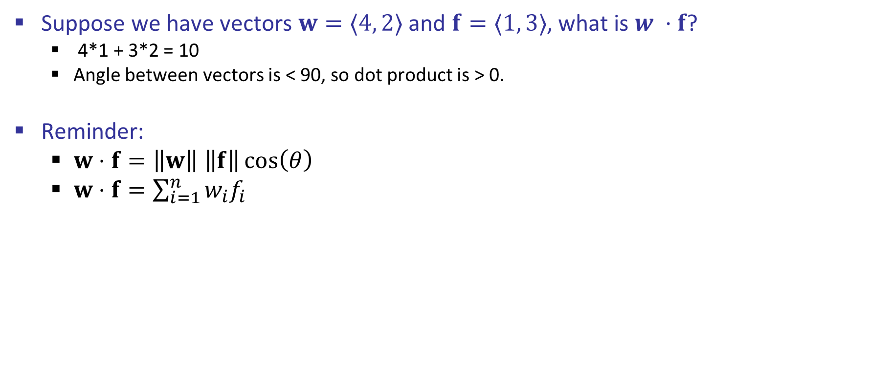
Very Brief Vector Review
c
Suppose we have vectors $w=〈4, 2〉$ and $f=〈1, 3〉$, what is $w ⋅f$?
4*1 + 3*2 = 10
Angle between vectors is < 90, so dot product is > 0.
Reminder:
$w⋅f=\left\|w\right\| \left\|f\right\|\cos\left(θ\right)$
$w⋅f=\sum_{i=1}^{n}{w_{i}f_{i}}$
f
w

Slide 11
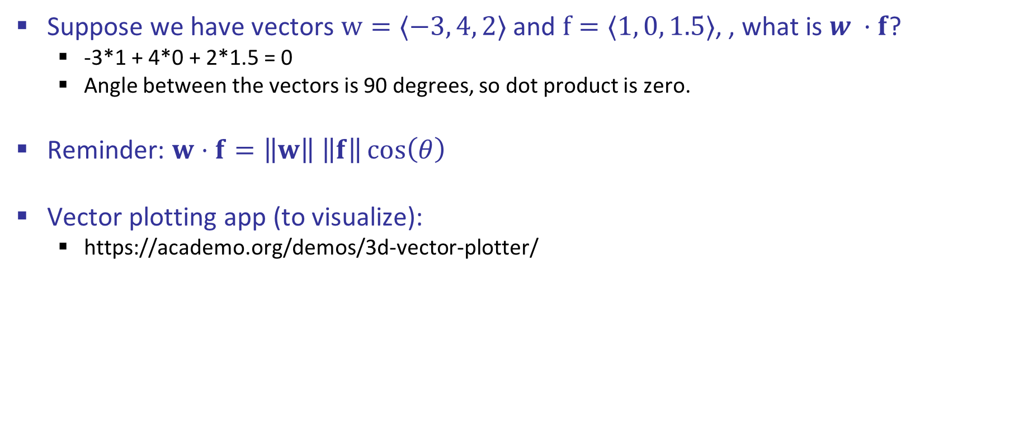
Very Brief Vector Review
c
Suppose we have vectors $w=〈−3, 4, 2〉$ and $f=〈1, 0, 1.5〉$, , what is $w ⋅f$?
-3*1 + 4*0 + 2*1.5 = 0
Angle between the vectors is 90 degrees, so dot product is zero.
Reminder: $w⋅f=\left\|w\right\| \left\|f\right\|\cos\left(θ\right)$
Vector plotting app (to visualize):
https://academo.org/demos/3d-vector-plotter/

Slide 12

Error-Driven Classification

Slide 13
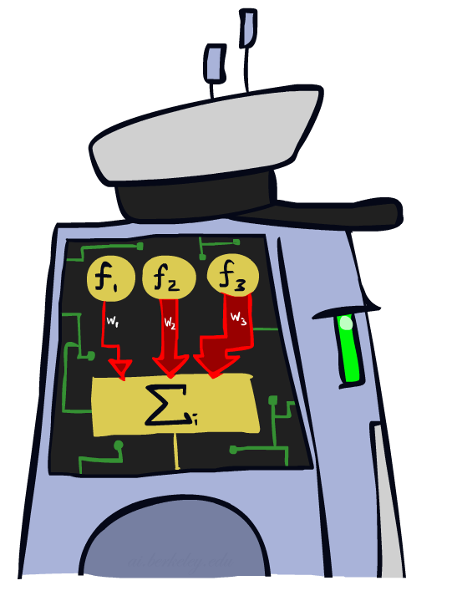
Linear Classifiers

Slide 14
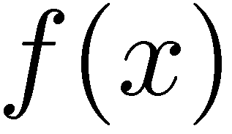

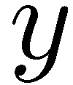

Feature Vectors (from last time)
Hello,
Do you want free printr cartriges? Why pay more when you can get them ABSOLUTELY FREE! Just
# free : 2
YOUR_NAME : 0
MISSPELLED : 2
FROM_FRIEND : 0
...
SPAM
or
+
PIXEL-7,12 : 1
PIXEL-7,13 : 0
...
NUM_LOOPS : 1
...
“2”

Slide 15

Some (Simplified) Biology
Very loose inspiration: human neurons
Don’t get too excited, the metaphor is pretty far from reality.

Slide 16
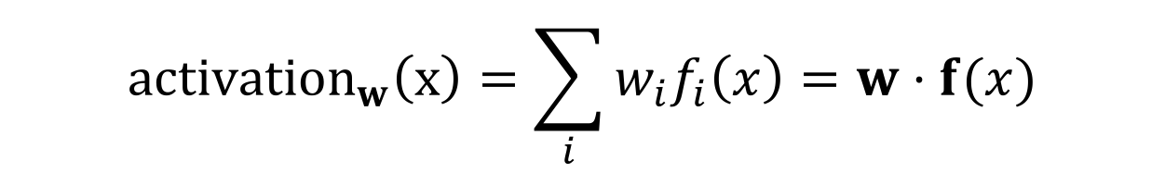
Linear Classifiers
Inputs are feature values
Each feature has a weight
Sum is the activation
If the activation is:
Positive, output +1
Negative, output -1
$${activation}_{w}\left(x\right)=\sum_{i}{w_{i}f_{i}\left(x\right)=w⋅f(x)}$$
w₁
f₁
Σ
w₂
>0?
f₂
w₃
f₃

Slide 17
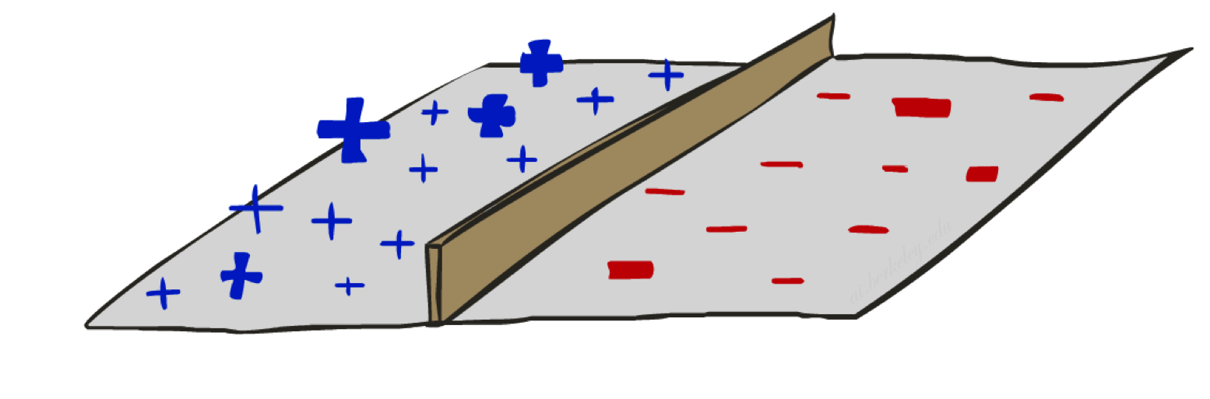
Decision Rules

Slide 18

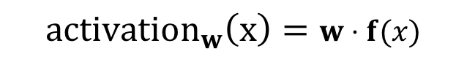
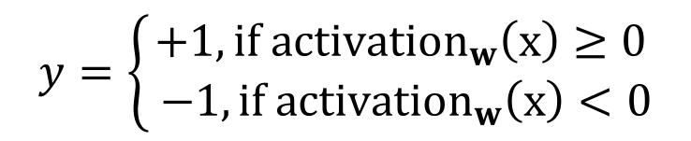
Binary Decision Rule
If we have two classes (i.e. need to make binary decision):
Have a weight vector for the “positive” class, e.g. spam
For any given input x, perceptron calculates activation level on that input’s features.
If activation is positive, perceptron believes it has seen the positive class.
Sort of like this: https://www.youtube.com/watch?v=l7op92W7voE
$$w$$
$${activation}_{w}\left(x\right)=w⋅f(x)$$
$$y=\left\{\begin{aligned}+1, if{ activation}_{w}\left(x\right)≥0 \\ −1,{if activation}_{w}\left(x\right)<0\end{aligned}\right.$$

Slide 19
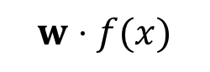
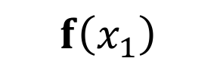
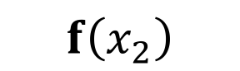

Binary Decision Rule: Geometric Interpretation #1
Classification rule: if angle between weight vector and feature vector < 90, assume the positive class.
d1scount : 4
YOUR_NAME :-1
MISSPELLED : 1
FROM_FRIEND :-3
...
d1scount : 2
YOUR_NAME : 0
MISSPELLED : 2
FROM_FRIEND : 0
...
$$w$$
$$f\left(x_{1}\right)$$
$$f\left(x_{2}\right)$$
d1scount : 0
YOUR_NAME : 1
MISSPELLED : 1
FROM_FRIEND : 1
...
$$w⋅f(x)$$
Dot product positive means the positive class

Slide 20
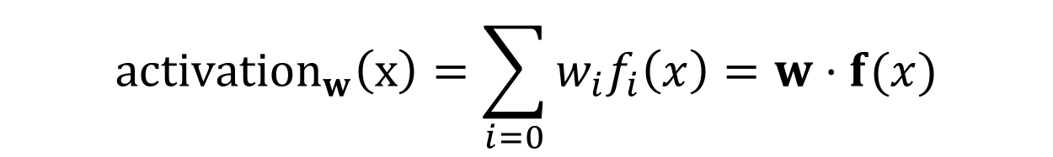
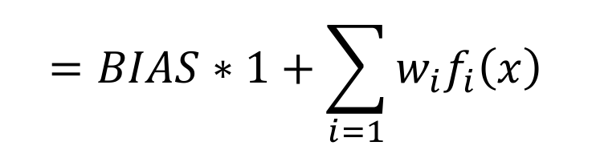
Bias Trick
Suppose we want to take into account that one class is inherently more likely:
Set first entry of weight vector to a so-called “BIAS” value.
Set first entry of feature vector to 1, regardless of input.
Net effect of this trick is to add a constant offset to our activation.
Similar to a y-intercept in slope-intercept form of a line.
$${activation}_{w}\left(x\right)=\sum_{i=0}{w_{i}f_{i}\left(x\right)=w⋅f(x)}$$
$$=BIAS∗1+\sum_{i=1}{w_{i}f_{i}\left(x\right)}$$

Slide 21


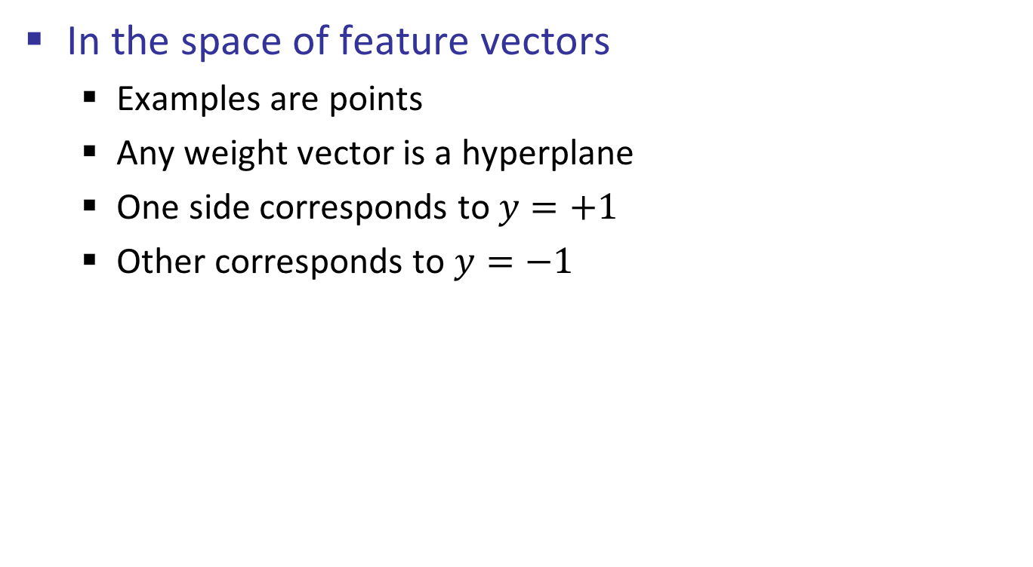
Binary Decision Rule: Geometric Interpretation #2
In the space of feature vectors
Examples are points
Any weight vector is a hyperplane
One side corresponds to $y=+1$
Other corresponds to $y=−1$
money
2
BIAS : -3
free : 4
money : 2
...
1
0
0
1
free

Slide 22
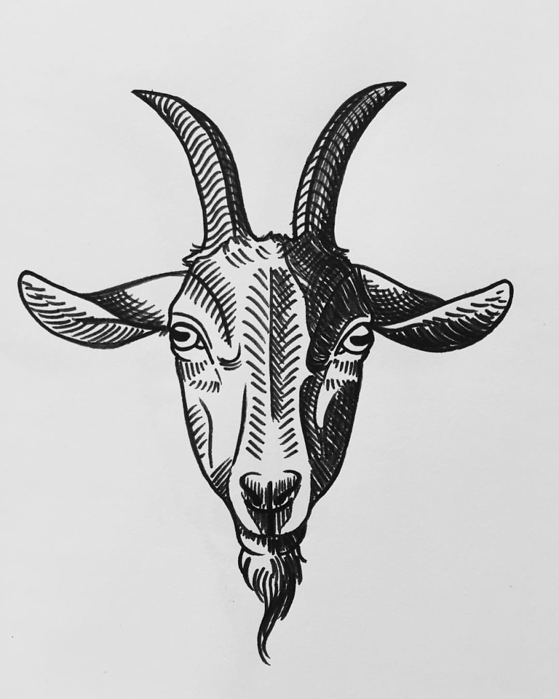
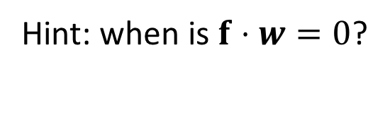
Find the Separating Hyperplane (line)
In the space of feature vectors
Examples are points
Any weight vector is a hyperplane
One side corresponds to $y=+1$
Other corresponds to $y=−1$
money
2
BIAS : -3
free : 4
money : 2
...
1
0
0
1
free
Draw the line that separates “ham” from “spam”, and label the two resulting half-planes.
Hint: when is $f⋅w=0$?

Slide 23

Binary Decision Rule: Geometric Interpretation #2
In the space of feature vectors
Examples are points
Any weight vector is a hyperplane
One side corresponds to $y=+1$
Other corresponds to $y=−1$
money
2
+1 = SPAM
BIAS : -3
free : 4
money : 2
...
1
0
-1 = HAM
0
1
free
$$f⋅w=0$$

Slide 24




Missing Piece: Learning the Weight Vector
Need a procedure for learning.
Input: huge number of labeled feature vectors
Output: weight vector
d1scount :??
YOUR_NAME :??
MISSPELLED :??
FROM_FRIEND :??
...
spam
d1scount : 2
YOUR_NAME : 0
MISSPELLED : 2
FROM_FRIEND : 0
...
$$f\left(x_{1}\right)$$
$$w$$
$$f\left(x_{3}\right)$$
d1scount : 3
YOUR_NAME : 1
MISSPELLED : 2
FROM_FRIEND : 0
...
d1scount : 0
YOUR_NAME : 1
MISSPELLED : 1
FROM_FRIEND : 1
...
$$f\left(x_{2}\right)$$
spam
ham

Slide 25
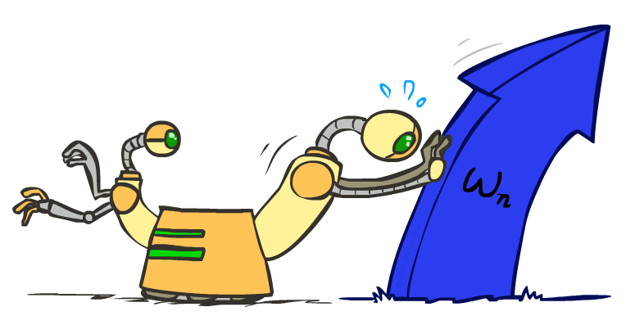
Weight Updates

Slide 26
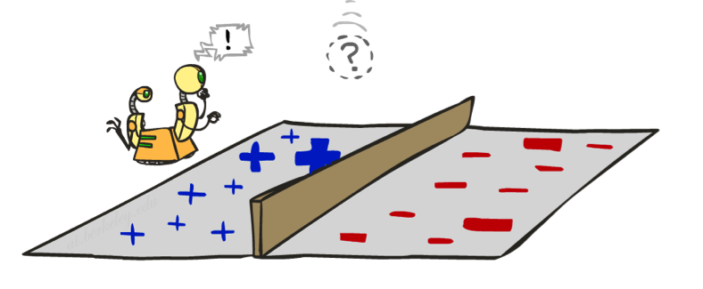
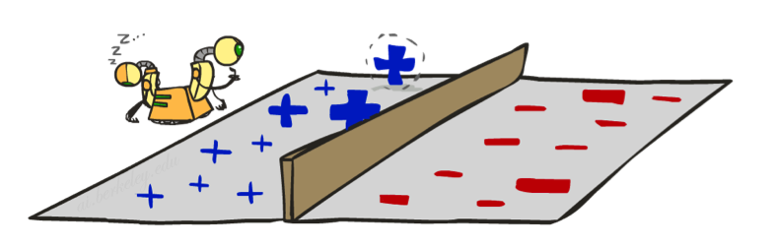
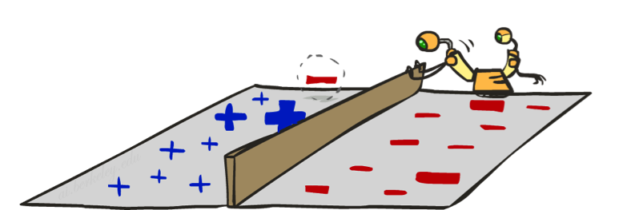
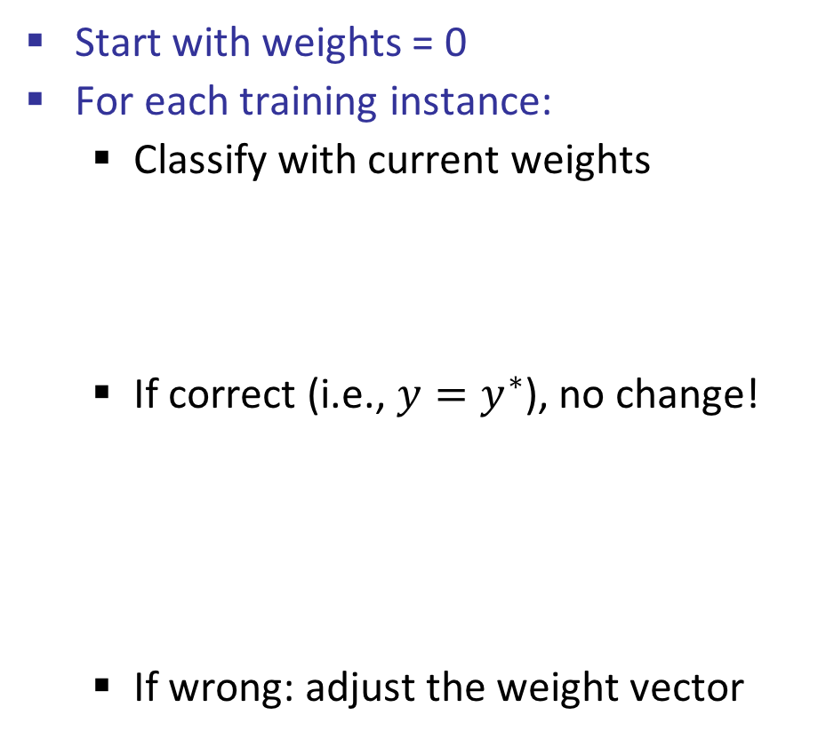
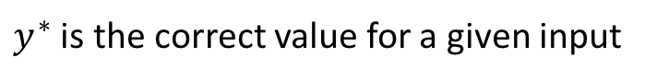
Learning: Binary Perceptron
Start with weights = 0
For each training instance:
Classify with current weights
If correct (i.e., $y=y^{∗}$), no change!
If wrong: adjust the weight vector
$y^{∗}$ is the correct value for a given input
Notes:
http://isl.ira.uka.de/neuralNetCourse/2004/VL_11_5/Perceptron.html

Slide 27
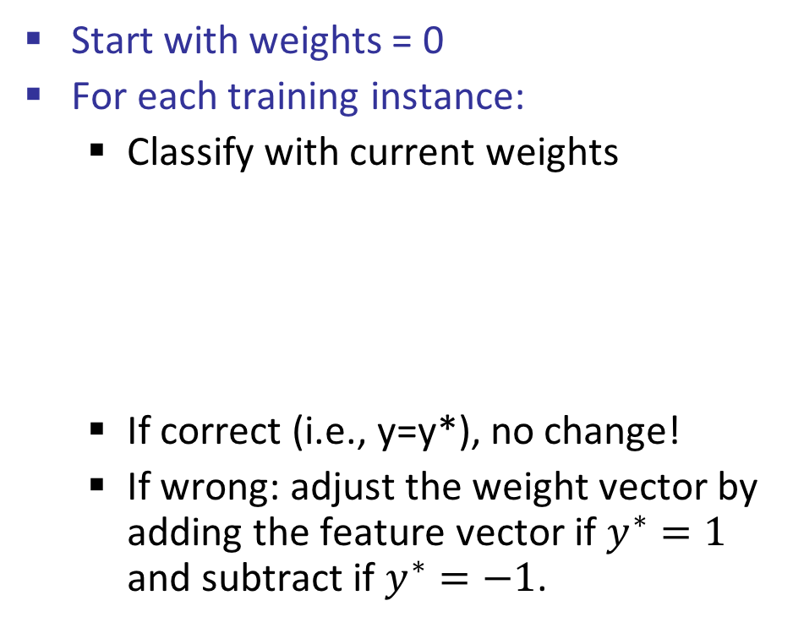
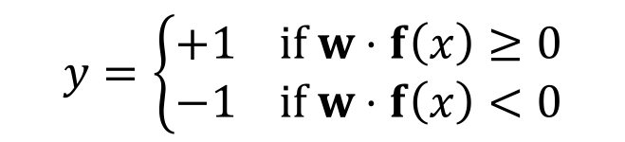


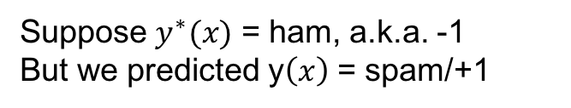




Learning: Binary Perceptron
Start with weights = 0
For each training instance:
Classify with current weights
If correct (i.e., y=y*), no change!
If wrong: adjust the weight vector by adding the feature vector if $y^{∗}=1$ and subtract if $y^{∗}=−1$.
$$w$$
$$−f$$
$$y=\left\{\begin{aligned}+1 if w⋅f\left(x\right)≥0 \\ −1 if w⋅f\left(x\right)<0\end{aligned}\right.$$
$$f(x)$$
Updated $w$
Predicted -, was +:
$$w^{new}=w^{old}+f$$
Suppose $y^{∗}(x)$ = ham, a.k.a. -1
But we predicted y$\left(x\right)$ = spam/+1
Predicted +, was -:
$$w^{new}=w^{old}−f$$
Notes:
http://isl.ira.uka.de/neuralNetCourse/2004/VL_11_5/Perceptron.html

Slide 28
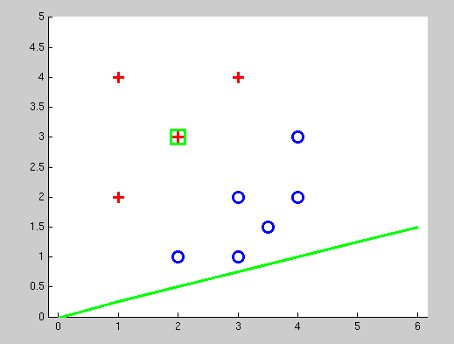
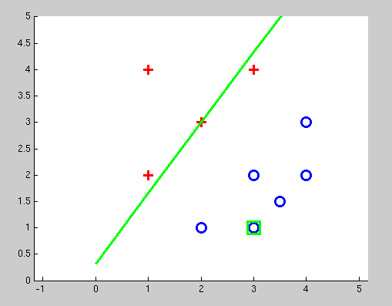
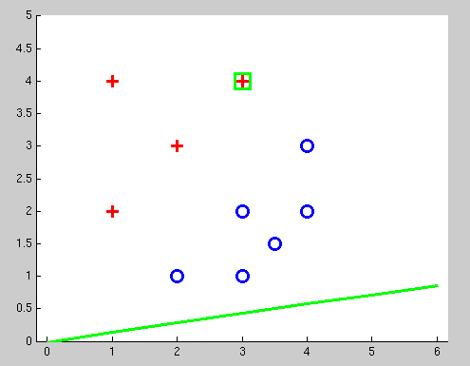
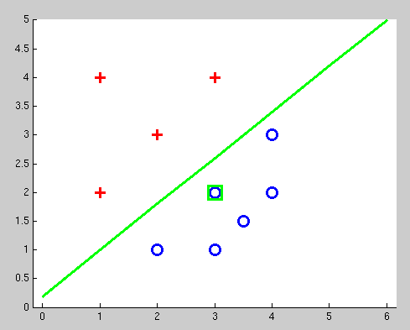
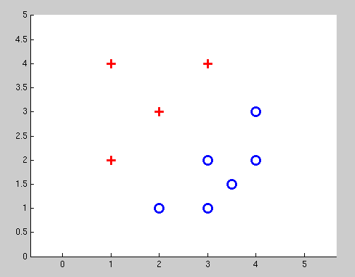
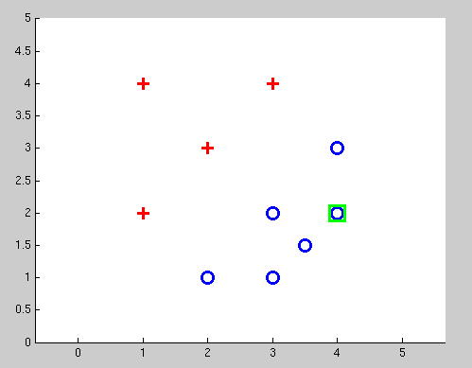
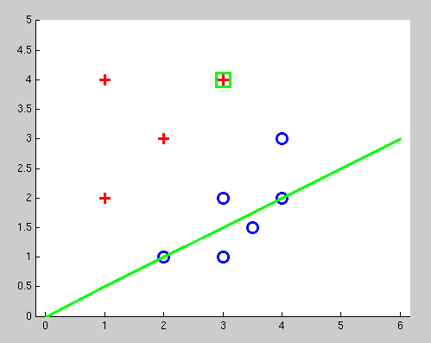
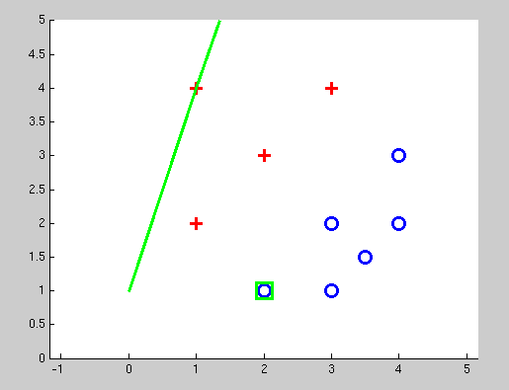
Examples: Perceptron
Separating plane jumps fairly erratically before settling down.
In each image, we’re seeing what happened AFTER updating weight.

Slide 29
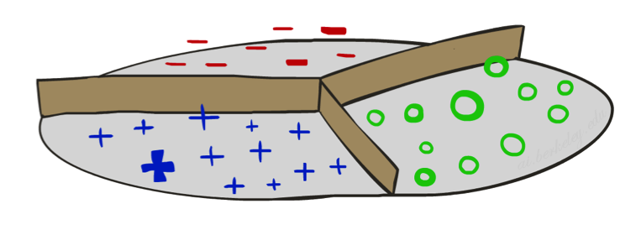
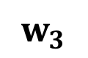
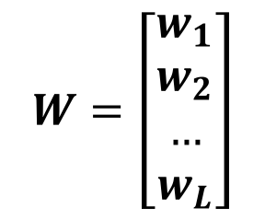

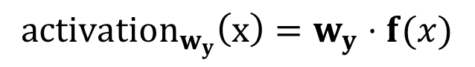

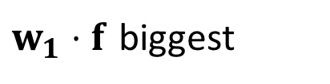
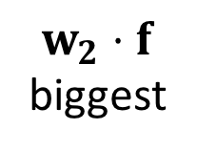
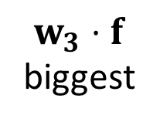
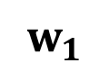
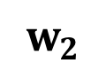
Multiclass Decision Rule
If we have multiple classes:
One weight vector for each class:
Can think of all vectors forming a matrix.
Score (activation) of a class y:
Prediction highest score wins
$$W=\left[\begin{aligned}w_{1} \\ w_{2} \\ … \\ w_{L}\end{aligned}\right]$$
$$w_{y}$$
$w_{1}⋅f$ biggest
$$w_{1}$$
$${activation}_{w_{y}}\left(x\right)=w_{y}⋅f(x)$$
$$w_{3}$$
$$w_{2}$$
$w_{3}⋅f$
biggest
$w_{2}⋅f$
biggest
$$y=\arg{\max_{y }{w_{y}⋅f(x){ }}}$$
Binary = multiclass where the negative class has weight zero

Slide 30
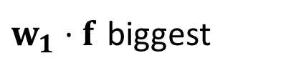

Geometry Warning!
In the multiclass case, angle is not the only determining factor.
Magnitude of weight vectors matter!
$w_{1}⋅f$ biggest
$$w_{1}$$
$$w_{2}$$
$$w_{3}$$
$w_{3}⋅f$
biggest
$w_{2}⋅f$
biggest

Slide 31













Learning: Multiclass Perceptron
$$w_{y}$$
Start with all weights = 0
Pick up training examples one by one
Predict with current weights
If correct, no change!
If wrong: subtract $f$ from wrong answer, add $f$ to correct answer, all other weight vectors unchanged.
$$f$$
$$w_{y^{∗}}$$
$$y=\arg{\max_{y }{w_{y}⋅f(x){ }}}$$
$$w_{5}$$
$$w_{y}$$
$$f$$
$$w_{y}$$
$$f$$
$$w_{y^{∗}}$$
$$w_{y}=w_{y}−f(x)$$
$$w_{y^{∗}}$$
Wrong:
$$w_{y^{∗}}=w_{y^{∗}}+f(x)$$
Before
Correct:
After
$$w_{5}$$
$$w_{5}$$

Slide 32



Perceptron Demo
“win the vote”
“win the election”
“win the game”
BIAS : 1
win : 0
game : 0
vote : 0
the : 0
...
BIAS : 0
win : 0
game : 0
vote : 0
the : 0
...
BIAS : 0
win : 0
game : 0
vote : 0
the : 0
...

Slide 33
Demo: Multiclass Perceptron
See webcast.
Or try it yourself by downloading https://drive.google.com/file/d/0B3UAxDgZnbC_X1h6QnhScVlVVEk/view
(won’t display in browser, you have to actually download it and open it locally)

Slide 34

Properties of Perceptrons
Separable
Separability: true if there exists some set of parameters that gets the training set perfectly correct (i.e. there exists a separating hyperplane)
Convergence: if the training data is separable, perceptron will eventually converge (binary case)
Mistake Bound: can mathematically compute the maximum number of mistakes (binary case) as a function of the margin or degree of separability [well beyond scope of this course]
Non-Separable

Slide 35



Examples: Perceptron
Non-Separable Case

Slide 36

Improving the Perceptron

Slide 37








Problems with the Perceptron
Noise: if the data isn’t separable, weights might thrash
Averaging weight vectors over time can help (averaged perceptron)
Mediocre generalization: finds a “barely” separating solution
Overtraining: test / held-out accuracy usually rises, then falls
Overtraining is a kind of overfitting

Slide 38







Fixing the Perceptron
Idea: adjust the weight update to mitigate these effects
Issue: when we saw x, predicted $y$, but answer was $y^{∗}$, we did the “lazy” thing, causing huge swings:
Added $f(x)$ to $w_{y^{∗}}$
Subtracted $f(x)$ from $w_{y}$
MIRA*: choose an update size that fixes the current mistake…
… but, minimizes the change to $W=$
$$w_{y}$$
$$f(x)$$
$$w_{y^{∗}}$$
$$w_{5}$$
$$\left[\begin{aligned}w_{1} \\ w_{2} \\ … \\ w_{L}\end{aligned}\right]$$
To do this:
Still going to change only $w_{y}$ and $w_{y^{∗}}$ i.e. bystander vectors like $w_{5}$ are left untouched.
Still going to change in the same direction, just by less!

Slide 39






Fixing the Perceptron
Idea: adjust the weight update to mitigate these effects
MIRA*: choose an update size that fixes the current mistake…
… but, minimizes the change to $W=$
Handy idea: Define $τ$ to be how much we want to use $f(x)$, i.e.
$w_{y}^{new}=w_{y}^{old}−τf(x)$
$w_{y^{∗}}^{new}=w_{y^{∗}}^{old}+τf(x)$
$$w_{y}^{old}$$
$$w_{y}^{new}??$$
$$\left[\begin{aligned}w_{1} \\ w_{2} \\ … \\ w_{L}\end{aligned}\right]$$
$$w_{y^{∗}}^{new}??$$
$$w_{y^{∗}}^{old}$$
$$w_{5}$$

Slide 40

Sanity Check Question
Idea: adjust the weight update to mitigate these effects
MIRA*: choose an update size that fixes the current mistake…
… but, minimizes the change to $W=$
Handy idea: Define $τ$ to be how much we want to use $f(x)$, i.e.
$w_{y}^{new}=w_{y}^{old}−τf(x)$
$w_{y^{∗}}^{new}=w_{y^{∗}}^{old}+τf(x)$
What happens if we set $τ=0$? $τ=1$?
$$w_{y}^{old}$$
$$w_{y}^{new}??$$
$$\left[\begin{aligned}w_{1} \\ w_{2} \\ … \\ w_{L}\end{aligned}\right]$$
$$w_{y^{∗}}^{new}??$$
$$w_{y^{∗}}^{old}$$
$$w_{5}$$

Slide 41

Sanity Check Question
Idea: adjust the weight update to mitigate these effects
MIRA*: choose an update size that fixes the current mistake…
… but, minimizes the change to $W=$
Handy idea: Define $τ$ to be how much we want to use $f(x)$, i.e.
$w_{y}^{new}=w_{y}^{old}−τf(x)$
$w_{y^{∗}}^{new}=w_{y^{∗}}^{old}+τf(x)$
What happens if we set $τ=0$? $τ=1$?
$τ=0$: Our algorithm never learns.
$τ=1$: We have the original perceptron algorithm, which shoves too hard.
$$w_{y}^{old}$$
$$w_{y}^{new}??$$
$$\left[\begin{aligned}w_{1} \\ w_{2} \\ … \\ w_{L}\end{aligned}\right]$$
$$w_{y^{∗}}^{new}??$$
$$w_{y^{∗}}^{old}$$
$$w_{5}$$

Slide 42

Measuring Fixed Mistake
Idea: adjust the weight update to mitigate these effects
MIRA*: choose an update size that fixes the current mistake…
… but, minimizes the change to $W=$
Handy idea: Define $τ$ to be how much we want to use $f(x)$, i.e.
$w_{y}^{new}=w_{y}^{old}−τf(x)$
$w_{y^{∗}}^{new}=w_{y^{∗}}^{old}+τf(x)$
$$w_{y}^{old}$$
$$w_{y}^{new}??$$
$$\left[\begin{aligned}w_{1} \\ w_{2} \\ … \\ w_{L}\end{aligned}\right]$$
$$w_{y^{∗}}^{new}??$$
$$w_{y^{∗}}^{old}$$
$$w_{5}$$
Give an expression that indicates we’ve fixed the current mistake.

Slide 43


Measuring Fixed Mistake
Idea: adjust the weight update to mitigate these effects
MIRA*: choose an update size that fixes the current mistake…
… but, minimizes the change to $W=$
Handy idea: Define $τ$ to be how much we want to use $f(x)$, i.e.
$w_{y}^{new}=w_{y}^{old}−τf(x)$
$w_{y^{∗}}^{new}=w_{y^{∗}}^{old}+τf(x)$
$$w_{y}^{old}$$
$$w_{y}^{new}??$$
$$\left[\begin{aligned}w_{1} \\ w_{2} \\ … \\ w_{L}\end{aligned}\right]$$
$$w_{y^{∗}}^{new}??$$
$$w_{y^{∗}}^{old}$$
$$w_{5}$$
Give an expression that indicates we’ve fixed the current mistake.
$$w_{y^{∗}}^{new}⋅f(x)≥w_{y}^{new}⋅f(x)$$

Slide 44

Measuring Change in W
Idea: adjust the weight update to mitigate these effects
MIRA*: choose an update size that fixes the current mistake…
… but, minimizes the change to $W=$
Handy idea: Define $τ$ to be how much we want to use $f(x)$, i.e.
$w_{y}^{new}=w_{y}^{old}−τf(x)$
$w_{y^{∗}}^{new}=w_{y^{∗}}^{old}+τf(x)$
$$w_{y}^{old}$$
$$w_{y}^{new}??$$
$$\left[\begin{aligned}w_{1} \\ w_{2} \\ … \\ w_{L}\end{aligned}\right]$$
$$w_{y^{∗}}^{new}??$$
$$w_{y^{∗}}^{old}$$
$$w_{5}$$
$$w_{y^{∗}}^{new}⋅f(x)≥w_{y}^{new}⋅f(x)$$
Give an expression that indicates we’ve fixed the current mistake.
Give an expression that computes the change in $W$ (hard question with obvious answer!).

Slide 45


Measuring Change in W
Idea: adjust the weight update to mitigate these effects
MIRA*: choose an update size that fixes the current mistake…
… but, minimizes the change to $W=$
Handy idea: Define $τ$ to be how much we want to use $f(x)$, i.e.
$w_{y}^{new}=w_{y}^{old}−τf(x)$
$w_{y^{∗}}^{new}=w_{y^{∗}}^{old}+τf(x)$
$$w_{y}^{old}$$
$$w_{y}^{new}??$$
$$\left[\begin{aligned}w_{1} \\ w_{2} \\ … \\ w_{L}\end{aligned}\right]$$
$$w_{y^{∗}}^{new}??$$
$$w_{y^{∗}}^{old}$$
$$w_{5}$$
$$w_{y^{∗}}^{new}⋅f(x)≥w_{y}^{new}⋅f(x)$$
Give an expression that indicates we’ve fixed the current mistake.
Give an expression that computes the change in $W$.
There are many other reasonable answers!
$$\sum_{i=0}^{L}{\left\|w_{i}^{new}−w_{i}^{old}\right\|}$$

Slide 46




MIRA
Idea: adjust the weight update to mitigate these effects
MIRA*: choose an update size that fixes the current mistake…
… but, minimizes the change to w
$$w_{y}^{old}$$
$$w_{y}^{new}??$$
$$w_{y^{∗}}^{new}??$$
$$\min_{W}{\sum_{i=0}^{L}{\left\|w_{i}^{new}−w_{i}^{old}\right\|}}$$
$$w_{y^{∗}}^{old}$$
$$w_{5}$$
$$s.t. w_{y^{∗}}^{new}⋅f(x)≥w_{y}^{new}⋅f(x)$$
We saw $x$, predicted $y$, but $y^{∗}$ was the right answer, so we adjust weights as:
$$w_{y}^{new}=w_{y}^{old}−τf(x)$$
$$w_{y^{∗}}^{new}=w_{y^{∗}}^{old}+τf(x)$$

Slide 47


Slight Reframing of MIRA
Idea: adjust the weight update to mitigate these effects
MIRA*: choose an update size that fixes the current mistake…
… but, minimizes the change to w
This version of MIRA does a couple of slightly different things:
Insists that we correct by an arbitrary margin of 1.
Minimizes square of norm (doesn’t change algorithm, but...)
$$w_{y}^{old}$$
$$w_{y}^{new}??$$
$$w_{y^{∗}}^{new}??$$
$$\min_{W}{\frac{1}{2}\sum_{i=0}^{L}{{\left\|w_{i}^{new}−w_{i}^{old}\right\|}^{2}}}$$
$$w_{y^{∗}}^{old}$$
$$w_{5}$$
$$s.t. w_{y^{∗}}^{new}⋅f\left(x\right)≥w_{y}^{new}⋅f\left(x\right)+1$$
We saw $x$, predicted $y$, but $y^{∗}$ was the right answer, so we adjust weights as:
$$w_{y}^{new}=w_{y}^{old}−τf(x)$$
$$w_{y^{∗}}^{new}=w_{y^{∗}}^{old}+τf(x)$$

Slide 48







Minimum Correcting Update
$$\min_{W}{\frac{1}{2}\sum_{i=0}^{L}{{\left\|w_{i}^{new}−w_{i}^{old}\right\|}^{2}}}$$
$$w_{y}^{new}=w_{y}^{old}−τf(x)$$
$$w_{y^{∗}}^{new}=w_{y^{∗}}^{old}+τf(x)$$
$$s.t. w_{y^{∗}}^{new}⋅f\left(x\right)≥w_{y}^{new}⋅f\left(x\right)+1$$
(equivalent to, use substitution)
$$\min_{τ}{\sum_{i=0}^{L}{{\left\|τf(x)\right\|}^{2}}}$$
$$w_{y^{∗}}^{new}⋅f(x)$$
$$≥$$
$$w_{y}^{new}⋅f(x)+1$$
$$s.t. w_{y^{∗}}^{new}⋅f\left(x\right)≥w_{y}^{new}⋅f\left(x\right)+1$$
(substitute, solve for when condition is =)
$$\left(w_{y^{∗}}^{old}+τf\left(x\right)\right)⋅f\left(x\right)=\left(w_{y}^{old}−τf\left(x\right)\right)⋅f\left(x\right)+1$$
min not τ=0, or would not have made an error, so min will be where equality holds

Slide 49




Minimum Correcting Update
$$\left(w_{y^{∗}}^{old}+τf\left(x\right)\right)⋅f\left(x\right)=\left(w_{y}^{old}−τf\left(x\right)\right)⋅f\left(x\right)+1$$
$$w_{y}^{new}=w_{y}^{old}−τf(x)$$
$$w_{y^{∗}}^{new}=w_{y^{∗}}^{old}+τf(x)$$
(solve for $τ$, just algebra)
$$τ=\frac{\left(w_{y}^{old}−w_{y^{∗}}^{old}\right)⋅f\left(x\right)+1}{2f(x)⋅f(x)}$$
Or in English:
Shove the weight vector for the right prediction in the direction of the input-under-test, using $τ$ to say how hard
Shove the weight vector for the wrong prediction away from the input-under-test, using $τ$ to say how hard
The equation above lets us calculate a better $τ$ than the one we used before, which was 1.
$$w_{y}^{new}⋅f(x)$$
$$≥$$
$$w_{y}^{new}⋅f(x)+1$$
min not τ=0, or would not have made an error, so min will be where equality holds

Slide 50





Maximum Step Size
$$w_{y}^{new}⋅f(x)$$
$$≥$$
$$w_{y}^{new}⋅f(x)+1$$
In practice, don’t want updates that are too large
Example may be labeled incorrectly
You may not have enough features
Solution: cap the maximum possible value of τ with some constant C
Corresponds to an optimization that assumes non-separable data
Usually converges faster than perceptron
Usually better, especially on noisy data (i.e. data with mislabeled values)
$$τ=\min\left(\frac{\left(w_{y}^{old}−w_{y^{∗}}^{old}\right)⋅f\left(x\right)+1}{2f\left(x\right)⋅f\left(x\right)}, C\right)$$

Slide 51
Linear Separators
Which of these linear separators is optimal?

Slide 52




Support Vector Machines
Maximizing the margin: good according to intuition, theory, practice
Only support vectors matter; other training examples are ignorable
Support vector machines (SVMs) find the separator with max margin
Turns out that this is equivalent to minimizing the magnitudes of the weight vectors (!!)
Basically, SVMs are MIRA where you optimize over all examples at once
MIRA, repeat until satisfied:
$$\min_{W}{\frac{1}{2}{\left\|W^{new}−W^{old}\right\|}^{2}}$$
$$s.t. w_{y^{∗}}^{new}⋅f\left(x\right)≥w_{y}^{new}⋅f\left(x\right)+1$$
SVM, find the W such that: (via link)
$$\min_{W}{\frac{1}{2}{\left\|W\right\|}^{2}}$$
$$s.t. ∀i, y:w_{y^{∗}}⋅f\left(x_{i}\right)≥w_{y}⋅f\left(x_{i}\right)+1$$

Slide 53
Classification: Comparison
Naïve Bayes
Builds a model training data
Gives prediction probabilities
Strong assumptions about feature independence
One pass through data (counting)
Perceptrons / MIRA:
Makes less assumptions about data
Mistake-driven learning
Multiple passes through data (prediction)
Often more accurate

Slide 54




Note to Future Prospective 189 Students
We took it very easy on the linear algebra today!
If you plan on taking 189, make sure you’re feeling solid on linear algebra.
Refresh your math 54 (or equivalent knowledge).
Not a bad idea to take Math 110 first, but not totally necessary.
MIRA, repeat until satisfied:
SVM, find the W such that:
$$\min_{W}{\frac{1}{2}{\left\|W^{new}−W^{old}\right\|}^{2}}$$
$$\min_{W}{\frac{1}{2}{\left\|W\right\|}^{2}}$$
$$s.t. w_{y^{∗}}^{new}⋅f\left(x\right)≥w_{y}^{new}⋅f\left(x\right)+1$$
$$s.t. ∀i, y:w_{y^{∗}}⋅f\left(x_{i}\right)≥w_{y}⋅f\left(x_{i}\right)+1$$

Slide 55
Contest 2

Slide 56

Web Search

Slide 57


Extension: Web Search
Information retrieval:
Given information needs, produce information
Includes, e.g. web search, question answering, and classic IR
Web search: not exactly classification, but rather ranking
x = “Apple Computers”

Slide 58
Feature-Based Ranking
x = “Apple Computer”
x,
x,

Slide 59








Perceptron for Ranking
Inputs
Candidates
Many feature vectors:
One weight vector:
Prediction:
Update (if wrong):

Slide 60

Apprenticeship (time permitting)

Slide 61



Pacman Apprenticeship!
Examples are states s
Candidates are pairs (s,a)
“Correct” actions: those taken by expert
Features defined over (s,a) pairs: f(s,a)
Score of a q-state (s,a) given by:
How is this VERY different from reinforcement learning?
“correct” action a*
[Demo: Pacman Apprentice (L22D1,2,3)]

Slide 62

Video of Demo Pacman Apprentice

Slide 63
Next: Kernels and Clustering

